Slide 1
Advances in Guidance for Mars Entry, Descent, and Landing
Connor Noyes
Qualifying Exam
December 5th, 2018
Notes:
The presentation goal should be to convey what you have done and plan to do and why it is important and novel.

Slide 2
Outline
Entry, Descent, Landing Overview
Entry Guidance Review
Powered Descent Guidance Review
Related Stochastic Literature Review
Description of proposed approach
Applications to EDL
Conclusion, Questions, Discussion

Slide 3
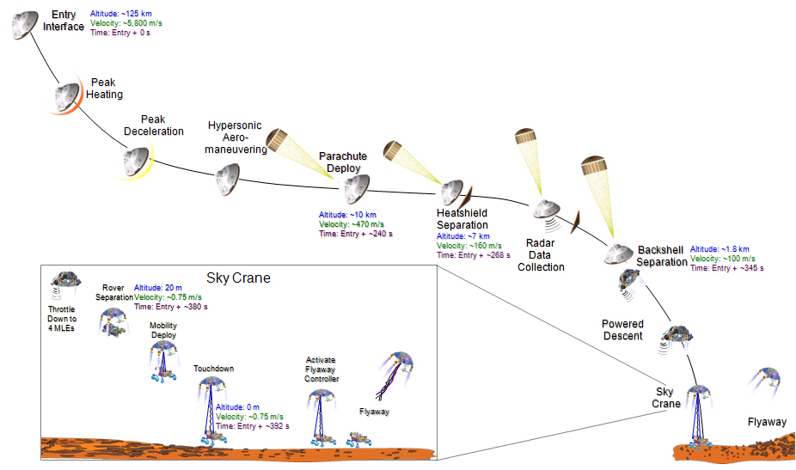
Mars Science Laboratory EDL Sequence
Descent Phase
Entry Phase:
~ 4 minute duration
Landing Phase
Notes:
Entry: steering vehicle to set up delivery to desired landing site. entry is the period of highest energy and greatest sensitivity for maneuvers on delivery point control
Supersonic parachute: reduce velocity to subsonic, L/D too low for capsule drag alone to slow fast enough.
Descent: final steering and soft landing.

Slide 4
Entry, Descent, and Landing State of the Art
Mars Science Laboratory - modified Apollo entry guidance, DGB Chute, Sky-Crane Descent stage
Low-lifting vehicle, L/D ~ 0.24, yields limited control authority
BC = m/(C_{D}*A) ~ 120 kg/m²
Predicted landing ellipse was 20 km long x 7 km wide
Phoenix: 100 x 20, Insight: 130 x 27 km
Reference trajectory designed for slow maneuvers and wide margins
Closed-loop performance evaluated via Monte Carlo
Iteration with human in the loop until margins are satisfied
Notes:
First guided entry at Mars
Apollo is based on neighboring optimal control

Slide 5
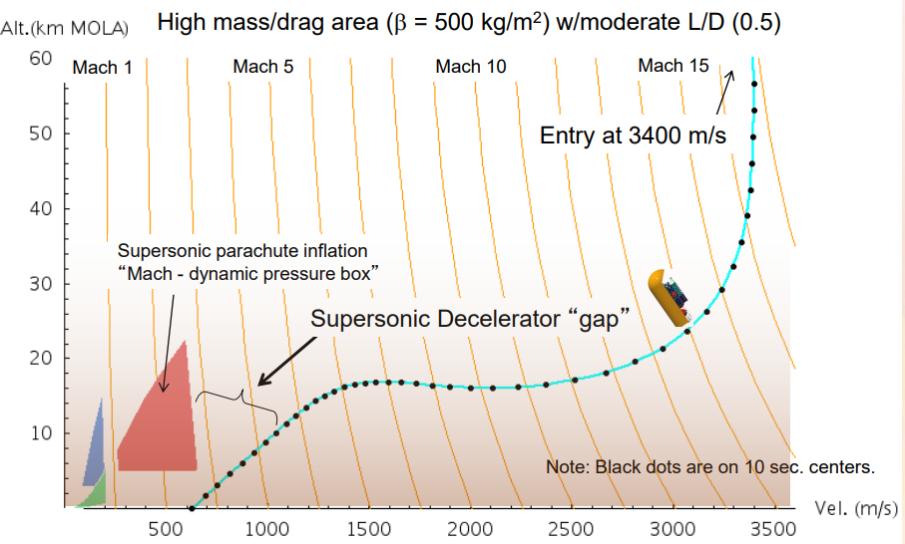
Future EDL Missions
Future missions will require delivery of heavier payloads while achieving greater accuracy
Human class missions will require more than 10x landed mass with NASA’s goal of 50 m precision
Parachute architectures simply do not scale to high ballistic coefficients¹
Supersonic retropropulsion (SRP) is one enabling technology²
Notes:
MSL guidance represents big step forward but significant additional guidance capability is required for future, and MSL guidance isn’t sufficient

Slide 6
EDL Concept of Operations
Entry phase – vehicle is guided by orienting the lift vector, controlled by reaction control thrusters
Bank angle is treated as the only control variable
Objective is to decelerate using atmospheric drag, and to deliver the vehicle to favorable ignition conditions
Powered descent phase – supersonic retropropulsion is used to null nearly all of the vehicle’s remaining velocity
3D thrust magnitude and direction is the control
Landing phase – final vertical descent phase to soft touchdown
Reduced set of thrusters is used to gently deliver the vehicle to the surface

Slide 7
Features of the Entry Phase
Flight dynamics are expressed in spherical coordinates
This simplifies expression of aerodynamic forces
State dimension = 6
Underactuated system with only one control variable
Limits on rate and acceleration of control variable
The exponential variation of atmospheric density with altitude coupled with nonlinear aerodynamic forces result in a wide dynamic operating range
Significant uncertainty exists due to insertion errors, environmental conditions, vehicle performance, navigation errors

Slide 8
Features of the Descent Phase
Dynamics comprise three double integrators (+ affine gravity term in vertical direction), and nonlinear mass dynamics
State dimension = 7
The vehicle’s thrust is subject to nonlinear, non-convex constraints that couple the coordinate directions
Uncertainty exists in ignition conditions, aerodynamic effects, engine performance (Isp, thrust) as well as transient effects
Additional constraints on pointing direction, shallow flight, and limited fuel availability

Slide 9
Entry Guidance Literature
Drag tracking
Provides inherent robustness to uncertainty in atmospheric density and aerodynamic forces due to the relationship between trajectory length
Neighboring optimal control
The Apollo guidance algorithm, as well as the modified version flown by MSL
Numerical Predictor-corrector
Repeatedly integrate the equations of motion to predict the trajectory, make improvements based on secant method
Requires restrictive, low-order parameterization for onboard feasibility
Successive Convex Optimization

Slide 10
Powered Descent Literature
Polynomial guidance – analytical approach
Flown on Apollo moon landing
No optimality, satisfaction of constraints via time of flight search
GFOLD – Convex optimization algorithm for fuel optimal powered descent
Guaranteed convergence for feasible problems with polynomial time complexity
Must solve problem repeatedly to search for optimal time of flight
Reduction to nonlinear root-solving problem based on necessary conditions from Pontryagin’s maximum principle
No convergence guarantees
Does not easily admit constraints
Notes:
GFOLD requires repeated solution for generate feedback; otherwise the bang-bang nature does not leave room for feedback
Our approach could be seen as a robust extension to GFOLD, especially if it can be solved via convex optimization
Probably not yet amenable to onboard implementation with current Mars tech

Slide 11
Stochastic Control - Related Work
Desensitized optimal control penalizes the partial derivatives of the objective function wrt parameters
Applied to entry phase and fuel-optimal powered descent
Closed relation between sensitivity and covariance reveals this is simply weighted covariance penalty
Mean-Variance framework trades off mean performance and robustness: J = E[x] + εV[x]
Decreasing the sensitivity of open-loop optimal solutions in decision making under uncertainty
We can construct Pareto optimal frontier by varying ε; choose how much performance to sacrifice
Notes:
A large number of papers deal with similar topics under a variety of different names
Linear exponential, risk sensitive, probabilistic control, covariance steering
Stochastic versus parametric uncertainty
Open loop vs closed loop
Constrained
Linear vs nonlinear

Slide 12
Drawbacks/Limitations of Existing Stochastic Approaches
Desensitized control does not make use of statistical information
Indeed, performance evaluations are conducted using parameters governed by distributions and we can use this information explicitly
Few papers discuss closed-loop approaches
Those that do avoid the issue of control constraints and instead impose arbitrary limits on the feedback gains or exclude feedback gains from the optimization process entirely
Generally only demonstrated on 2d examples, many proposed solutions do not scale well with increasing dimension

Slide 13
Existing Applications of Stochastic Control to EDL
Desensitized entry and powered descent
Without enforcement of constraints except on mean trajectory
SRP application used a heuristic that drives feedback gains to zero near the boundary of control constraints
Variance penalization without confirmation of benefits
Linear covariance propagation was used but the control was never executed on the full nonlinear model in order to demonstrate that the linearized prediction was sufficient
Control saturation was not accounted for, which overestimates the effect the controller has on reducing the state covariance

Slide 14
How our approach is novel
Convex optimization methodology for onboard entry trajectory replanning
Based on the idea of warm-starting
Initial trajectory designed using results from hybrid optimal control
Stochastic view of the constrained SRP problem: looking at an entire tube of trajectories from the beginning of the design process
Exploit knowledge of the probabilistic nature of the uncertainty to improve performance
Reversal of common design order; reference trajectory is designed in view of closed-loop performance
The process may still require iteration if the chosen controller parameters are insufficient
In NLP formulations, gains and other controller parameters can be included in the optimization process

Slide 15
Guidance Approach for the Entry Phase

Slide 16
Switch Time Optimization for Rapid Entry Trajectory Design
Simple parameterization of bank angle profile for robust, near-optimal altitude performance intended for parachute architectures
Can demonstrate that this parameterization also allows for near-optimal minimum velocity performance, suitable for SRP applications

Slide 17
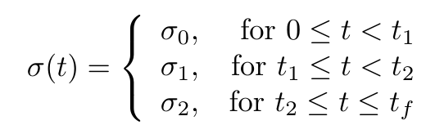
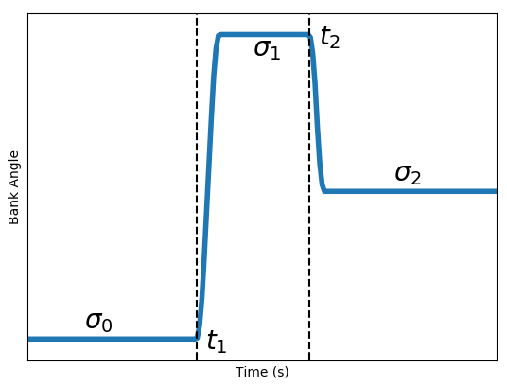
Low-order Parameterization
If-then logic used is discontinuous; Nelder-Mead simplex method has been used for optimization
Results from hybrid OC literature suggest a gradient based solution is possible and preferable
Can be computed via forward or adjoint sensitivities

Slide 18
Switch Time Optimization
Gradients with respect to switch times cannot be easily evaluated via finite difference, and automatic differentiation fails due to the discontinuous logic
Solved very efficiently via SQP method (quasi-Newton method, BFGS update to inverse Hessian)
For the 3-parameter problems here, typical convergence is < 5 iterations
We left margins heuristically, assumed a fixed % was sufficient for closed loop trajectories
In a future approach, the bank angle magnitudes become decision variables and the appropriate margin during each segment is determined automatically

Slide 19
Entry Trajectory Updating¹
The entry vehicle enters the atmosphere with a trajectory designed that will deliver it to the target under nominal conditions
Under off-nominal conditions, the vehicle will deviate from the trajectory that was planned, sometimes even with the aid of closed-loop guidance
Vehicle may arrive at the target under poor conditions (e.g. outside of parachute deployment conditions, poor SRP ignition point, etc.) or may violate important path constraints
Goal: use current estimated vehicle state and redesign a path to the target while satisfying constraints (e.g. parachute deploy conditions, path constraints)
¹ Noyes, C.D., Mease, K.D., A Convex Optimization Approach to Mars Entry Trajectory Updating, AAS Astrodynamics Specialist Conference, 2018.
Notes:
Entry vehicle flies with an angle of attack to generate lift
Vehicle is steered toward the target via rotation of the vehicle about the velocity vector to orient the lift vector
Many potential applications, including updates to a reference trajectory in a tracking approach, and predictor-corrector-like method based on regular repeated updates

Slide 20
Proposed Approach
Trajectory update is posed an optimal control problem
Objective is to minimize distance to original trajectory while satisfying terminal constraints
Use energy as independent variable
Convexify
Treat bank angle as additional state, use bank rate as the control variable
Linearize the equations of motion
Unlike powered descent case, convexification is not lossless
Discretize (or transcribe) into second-order cone program
Chebyshev pseudospectral method
Solve the resulting SOCP using efficient interior-point solver
Notes:
Minimizing distance to original trajectory keeps the linearization as accurate as possible
Treating the bank rate as control allows us to limit it, as an added benefit
Normal approaches are iterative, ours solves only a single problem
Bank limit becomes a path constraint, rather than control constraint

Slide 21
Convex Optimization
(Iterative) Convex optimization approaches to non-convex optimal control problems have exploded in interest due to efficient, polynomial time solvers and guaranteed global solution when the problem is feasible
A variety of aerospace problems have been solved including ascent trajectory design, powered descent trajectory design, interplanetary transfers, and entry
While these convex optimization guarantees solution of feasible sub-problems, not all methods have guaranteed convergence, and those that do typically require an unknown number of iterations
The proposed approach does not involve multiple iterations

Slide 22
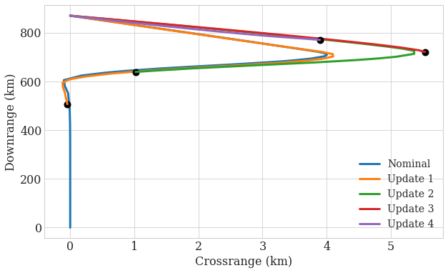
Single Trajectory Demonstration
Updates occur at 30s interval, and ceases below 1000 m/s
4% less drag, 4% more lift, and perturbations to atmospheric density are applied
Mismatch between state predicted by update 2 (green) and actual state due to parametric uncertainty and off-nominal atmospheric conditions is corrected by the following updates
Notes:
Corrections are fairly substantial even for relatively small perturbations

Slide 23
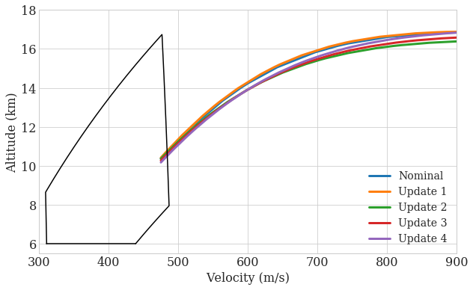
Single Trajectory (Cont.)
The initial trajectory was optimized for high altitude
The updates retain aspects of the original trajectory, e.g., altitude performance remains excellent
All trajectories end at the same energy level due to use of energy as independent variable
Parachute deployment box

Slide 24
Monte Carlo Simulation
Vehicle is nominally L/D = 0.24 with initial state subject to MSL-like dispersions
MarsGRAM is used for environment modeling
Uncertainty is added to lift and drag coefficients
Gaussian with 3σ = 10%
Updates occurs at 10 second intervals and stops at 600 m/s
Bank angle limited to ±90°, and bank rate limited to 20°/s
200 samples chosen by Sobol’ sequence
Trajectories terminate when they reach the correct downrange distance
Simple logic, but should expect variations in final altitude and velocity despite energy as independent variable
Notes:
No tracking, flown open-loop between plans, NO ADD’L LATERAL CONTROL
Low discrepancy sampling

Slide 25
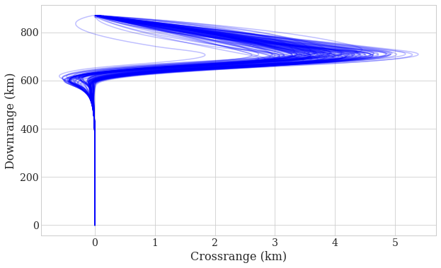
MCS Results - Groundtrack
Excellent crossrange performance due to coupled update to longitudinal and lateral channels
Interestingly, a small number of samples even have an additional reversal
Notes:
Note the difference in scale between the axes
Also, not all trajectories are plotted, too unclear otherwise (that’s why there are samples at +- 1km crossrange not seen in the plots

Slide 26
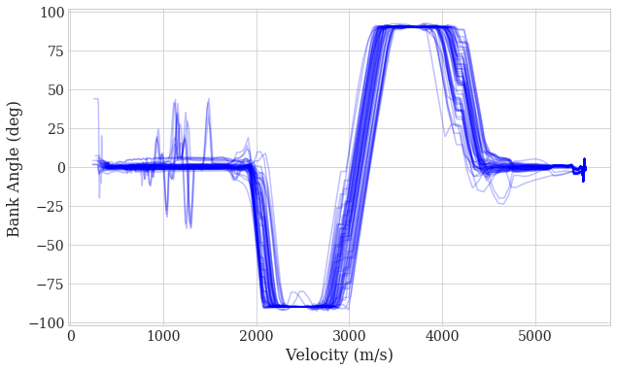
MCS Results – Bank Profiles
Largest difference is in the timing of bank reversals
Bank angle (and trajectory in general) deviates from the original trajectory most at the end
This is expected because the later portion of trajectory is updated the greatest number of times

Slide 27
Discussion
Despite the use of linearization requiring small, local updates, a convex approach to onboard trajectory redesign shows promise
Use of updating has a number of potential applications
If the target point is not reachable, the solution returned by the optimizer may be outside the region of validity of the linearized trajectory, or the optimization may return infeasible
Safeguarding is required
Consider the endpoint constraint as a penalty term in the objective

Slide 28
SRP via Chance Constrained Optimal Control
For Gaussian uncertainty, we cannot guarantee that constraints will be met due to unboundedness, instead they must be satisfied with at least a specified probability, this is referred to as a chance constraint
Extends existing results in Mean-Variance framework to closed-loop, chance constrained scenarios
Notes:
(Covariance minimization is just one particular objective)

Slide 29


Chance Constraints
Acceptable constraint violation
Y_{P}
Subset X_{P} with probability P
F(x)
Constraint boundary, c(y) = 0
This subset satisfies c(y) < 0 with probability at least P
If F(x) is injective, the constraint is satisfied with probability P, i.e., no conservatism is introduced
Initial Set, X
Reachable Set, Y
Idea: Use reachable set to turn probabilistic constraint into deterministic constraints
Given: an initial uncertainty set (possibly unbounded) and a constraint to be satisfied with probability P
Take a subset of the initial set that has probability P (this is not unique unless P=1)
Map the subset through the function F
If the mapped subset does not violate the constraints, then the probabilistic constraint is satisfied, i.e.
Let $C=\left\{y \right| c\left(y\right)≤0\}$
Then, $Y⊆C ⇒ P\left[y∈C\right]≥1−δ$
Two problems:
How to compute the reachable set efficiently?
How to impose constraints on the entire set?
Notes:
The more states involved in the constraint, the more checks we have to perform. For a 1-D constraint, we only have to check a line’s worth of points. However, we don’t need to check constraints for every possible x and every possible y, we only need to check for points (x,y) that are in the reachable set.
A little more work, and we can also simply check points that are extremal, but this requires determining which points are extremals.
Many common approaches introduce conservatism, for example by using probabilistic inequalities based on moments (which are not tight in general). This approach has zero conservatism when F is invertible. If F is not, then some conservatism is introduced but likely still much smaller than

Slide 30
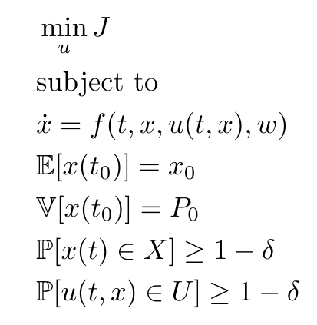
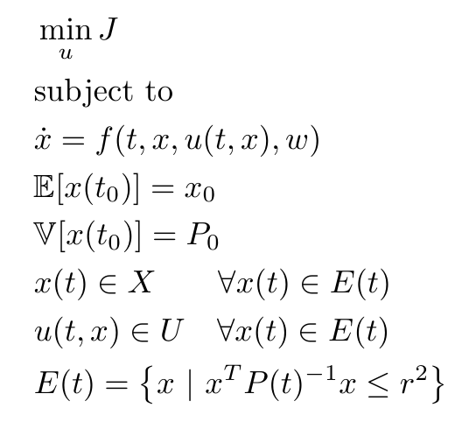
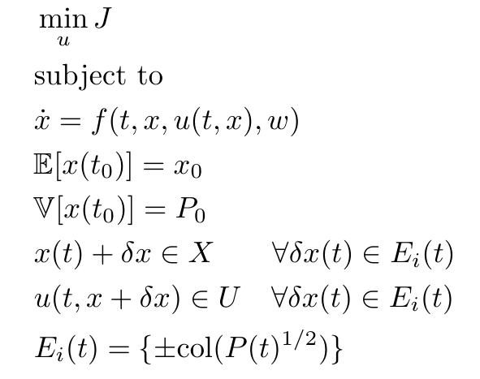
Our Current Approach
Reachable set is approximated by an ellipse around nominal trajectory based on the state covariance
Constraints are imposed on a finite number of points on the boundary of the ellipse, computed from the columns of the square root of the covariance matrix
Original Problem
Constraint Reformulation
Finite Constraint Relaxation
The boundary of the ellipse under consideration is decided by the level of constraint satisfaction
Notes:
Final constraints are not shown but are typically imposed on some partial states

Slide 31
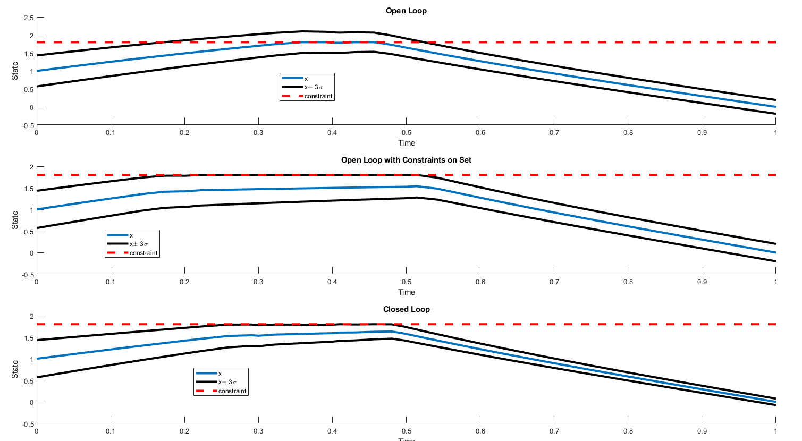

1D Example: $\dot{x}=−c\left|x\right|x+u$
Uncertainty only in initial state
Fixed final condition at the origin
Objective is to minimize the final variance, special case of mean-variance objective
The nonlinearity has a contracting effect, allowing even the open loop scenario to reduce the state variance
Provides the optimal bias of the reference from the constraint(s)
Notes:
Problem can be thought of as 1-D velocity regulation with disregard for position state

Slide 32
Application: Supersonic Retropropulsion
During vehicle design, we seek to minimize propellant use under uncertainty during the powered descent phase
J = -E[m(tf)]
This allows us to deliver the heaviest payload to the surface for a fixed total vehicle mass
When neglecting aerodynamic drag, the system is approximately linear
Drag coefficient can be modeled as one source of uncertainty
The system is subject to bounded thrust magnitude, glide-slope constraint that prevents shallow flight

Slide 33
Application Details
Loop is closed using LQR gains scheduled on vehicle mass
Even for the 2D system, the total number of differential equations is 45
Only initial condition uncertainty considered
Initial covariance matrix is not diagonal
The controller guiding the entry phase results in correlated states

Slide 34
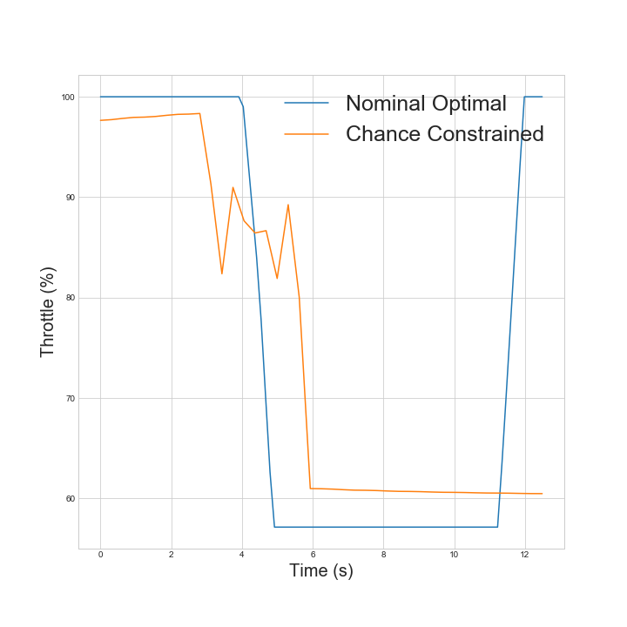
Numerical Results: Control
As the initial covariance grows, or as the feedback gains are increased, the chance constrained solution approaches a flat control halfway between the bounds
This offers maximal margin but degrades mean performance in favor of covariance reduction
P₀ ↑ or ||K|| ↑

Slide 35
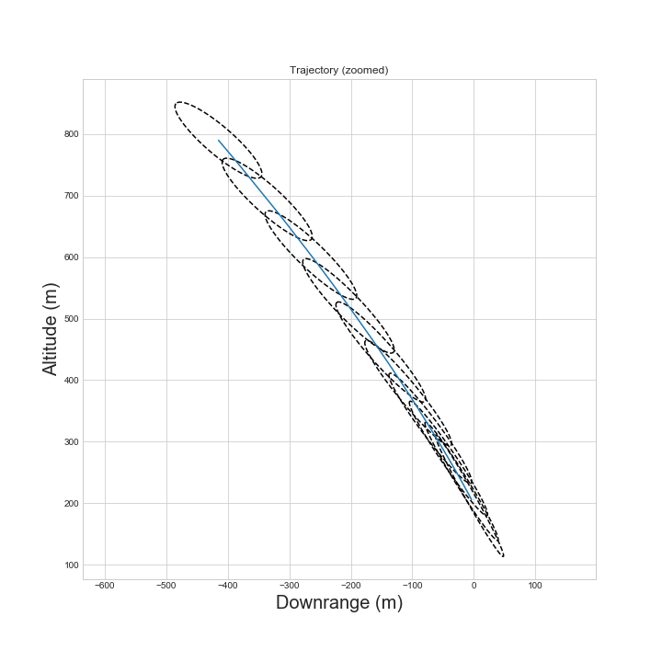
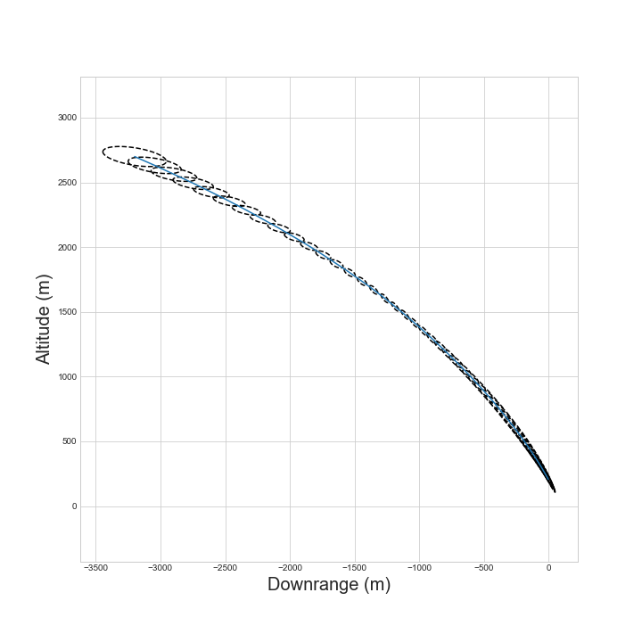
Numerical Results: Trajectory
All cases within 3σ ellipse have at least 100m altitude margin
SRP phase terminates before final vertical descent
Notes:
Some tuning is required; higher gain solutions should be pursued for better regulation
As we will see, the control is only slightly biased for this example, indicating relatively low feedback gains

Slide 36
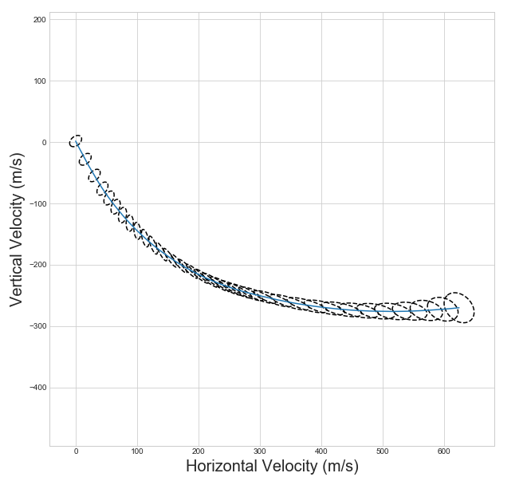
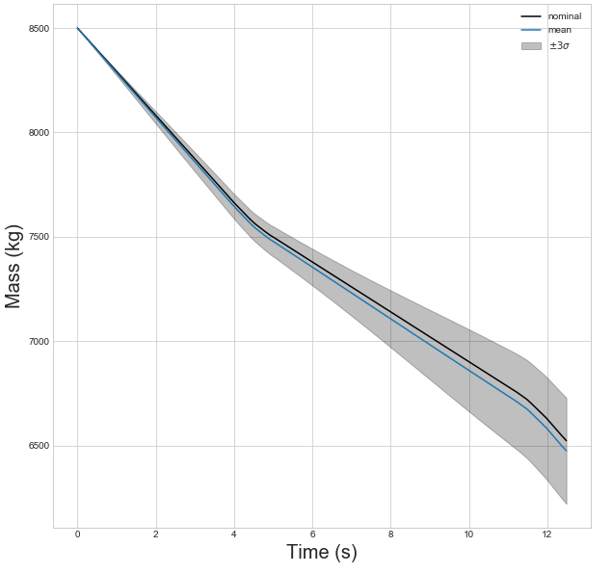
Numerical Results: Velocity
Final velocity
3σ = 10 m/s
Higher gains can be used for tighter regulation
Sigma points capture up to third order effects of uncertainty on the mean for Gaussian inputs

Slide 37
Discussion
Still requires tuning of LQR matrices
Larger gains result in tighter covariance but require that the mean is biased further from control bounds
Gain magnitude must be balanced with initial covariance, otherwise constraints become infeasible
Even for the pseudo-linear dynamics, LQR may not be optimal
It is not obvious in general whether it is preferable to reduce covariance early (allows closer mean performance to state constraints) or late (allows closer mean performance to control constraints)
Future work will include gains as optimization variables
Use of sigma points allows for nonlinear controllers to be used
Even with tractable approximations, the problem size grows quickly with uncertainties and state dimension
Custom solution method? For specified gains and fixed time, successive convex method is applicable
Notes:
Integral control can be used at the expense of more states

Slide 38
Roadmap: Work to Go
Stochastic SRP
Incorporate additional uncertainty
Potential for improving NLP solution methodology via sequential convex programming; UT grows problem size but for specified gains, the problem remains convex
Reformulate the constraints to achieve tighter satisfaction, guarantees
Extension to output feedback scenario with application to entry phase coupled with Apollo guidance, where the feedback states are nonlinear functions of the state variables
Multi-phase formulation that allows optimal ignition coupled with robust entry phase to achieve even lower fuel consumption
Multi-phase formulation without uncertainty considerations:
Noyes, C., Wolf, A., Benito, J., High Ballistic Coefficient Mars EDL with Supersonic Retropropulsion, AAS Guidance and Control Conference, 2017

Slide 39
Conclusion
Future missions will require advances in EDL guidance
Improved solution methodology for offline entry trajectory planning
Convex trajectory updating for online entry guidance
SRP using tube-based optimal control of constrained systems subject to uncertainty
Current approach provides a tractable approximation of chance constraints but does not guarantee their satisfaction
Reference trajectory is optimally biased away from active constraints
Resulting solution is optimal in a distributional sense

Slide 40
Targeted Landing Site
For the same optimal altitude, velocity, and flight path angle, any point on the red circle will produce an equivalent SRP trajectory so long as the heading points to the target
Optimal SRP Ignition (Nominal Scenario)
This is interesting because it means that unlike with parachute architectures which try hard to arrive near zero crossrange, there is no such restriction on SRP-based landings
Entry trajectory, steered by bank angle commands, executed by small
RCS thrusters
Downrange
Atmospheric entry interface
Crossrange

Slide 41
Outline
Entry phase (hybrid opt, convex updating)
SRP phase (robust solutions via optimal control)
Multi-phase optimal control (create reference for initialization entry, and to track in SRP phase potentially)
Adaptive SRP initiation via free initial condition OCP?
Free final time via free initial condition?
Non-standard control objectives: risk sensitive, minimally covariant trajectories

Slide 42
Trace Norm
From the broader class of Schatten p-norms with p=1
Also called the nuclear norm, equal to the sum of the singular values (= eigenvalues because covariance is positive semi-definite)

Slide 43
Literature Review
Linear Exponential Gaussian (weights higher moments)
Control of Liouville equation
Desensitized optimal control penalizes the partial derivatives of the objective function wrt parameters, or places constraints on sensitivities
Mean-Variance trades off mean performance and robustness
Decreasing the sensitivity of open-loop optimal solutions in decision making under uncertainty

Slide 44
Literature Review
Optimal Trajectory Generation with Probabilistic System Uncertainty Using Polynomial Chaos (Fisher, Bhattacharya)
Derived expressions for minimum expectation and minimum variance objectives in terms of PCE coefficients
Considered open loop
Stochastic Trajectory Optimization for Mechanical Systems with Parametric Uncertainties
Extended Differential Dynamic Programming to stochastic systems using polynomial chaos

Slide 45
Also Related
Tube-based formulations (MPC), invariant sets
PDF shaping

Slide 46
System Flow
Truth model,
a particular realization of the uncertainty space
Navigation system model
Knowledge errors, measurement noise
Guidance algorithm
Nominal model,
typically mean of each uncertainty is used
Prediction model
(if needed, not all guidance predicts future states)
Estimation
(aero filters, EKF, observers)

Slide 47
Modeling
True State
Estimation
Measurement Noise
Estimated State
Guidance algorithm
Propagation
Process Noise
Notes:
The full state vector is propagated inertially using IMU data
Accelerations are measured (with measurement errors) in body axes then converted (with orientation errors) into wind axes as lift and drag

Slide 48
Covariance Minimization
Consider first the LTV case, with unconstrained control
For suitable choice of norm on the final covariance matrix, the problem reduces to standard LQR with a particular boundary condition
The required norm is the trace operator
The LQ state weight matrix Q = I
The trace is a suitable choice in many cases
Geometrically, it is related to the size of the covariance ellipse, while ignoring directional information

Slide 49
Covariance Minimization
Next consider the same scenario with bounded control inputs
The optimal control law is bang-bang in nature
Can no longer decouple mean and covariance problems
In zero mean case, optimal control in linear feedback is achieved as K -> inf, resulting in bang-bang control = -Umax*sign(x)
Even for linear problems, we turn to optimization: find the optimal mean trajectory such that covariance is minimized under discontinuous feedback

Slide 50
Drawbacks/Limitations
Use of linearized covariance propagation limits the size of ellipse under consideration
Due to large uncertainty or stringent constraint satisfaction
Strong nonlinearity or large ellipse will not accurately capture the state distribution, and the probabilistic bounds are not guaranteed to be satisfied
Assumption of linear feedback control
Naturally there may exist nonlinear controllers that outperform linear feedback
Solution: Unscented transform
Relies on sampled trajectories which allows arbitrary dynamics and controller structure
Scales favorably with system dimension
Notes:
The finite size of the ellipse provides a very natural scaling for the sigma points, i.e. we choose the initial set of sigma points to be on the boundary of the initial ellipse
Can deal with parametric uncertainty in the same framework. Linear cov prop can deal with stochastic dynamics, how can we do that with sigma points?
Answer: the total covariance is the state covariance P and the stochastic covariance Q along the diagonal [P 0; 0 Q]. Thus, any channel in which the noise acts increased the number of sigma points by 2

Slide 51
Planned Application: Entry Guidance
The large nonlinearities and limited control authority present in the entry phase make it a more challenging application
Additionally, full state feedback is not realistic
LQR is not sufficient here
Low order parametrization reduces the infinite dimensional OCP to a tractable optimization problem
Modified Apollo guidance is used to generate the feedback gains scheduled on navigated velocity

Slide 52
Introduction
Future Mars missions will have challenging requirements that necessitate closed-loop entry guidance
The ability to design a trajectory onboard increases autonomy and can be used in entry guidance
Trajectory generation can be used in reference tracking methods, or as the basis for a numerical predictor-corrector method via frequent design
Generating an optimal trajectory onboard is difficult due to limited computing resources
Notes:
Can either augment an existing approach, or form the basis for a new one
Need to balance computation requirements

Slide 53
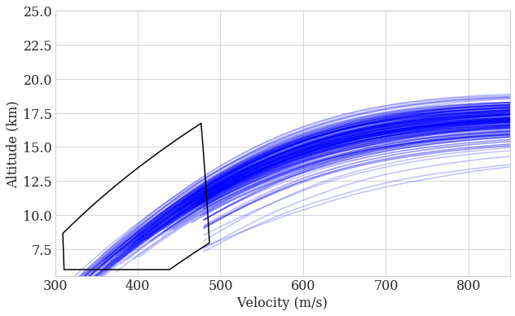
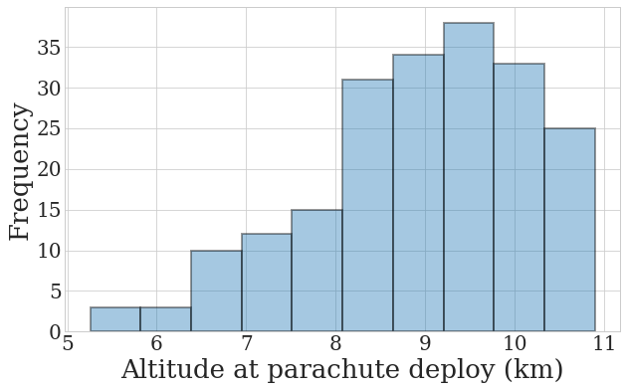
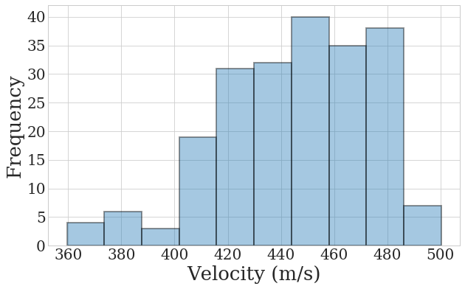
MCS Results – Altitude/Velocity
Although some trajectories exit the parachute deployment conditions, all but three pass through the box
Solved by considering triggering logic that explicitly accounts for parachute conditions

Slide 54
MODIFY

